Slide 1
Le Preposizioni

Slide 2
Le Preposizioni semplici
(Simple prepositions)
A preposition describes a relationship between other words in a sentence. In itself, a word like "in" or "after" is rather meaningless and hard to define in mere words. For instance, when you do try to define a preposition like "in" or "between" or "on," you invariably use your hands to show how something is situated in relationship to something else.

Slide 3
A preposition describes a relationship between other words in a sentence. In itself, a word like "in" or "after" is rather meaningless and hard to define in mere words. For instance, when you do try to define a preposition like "in" or "between" or "on," you invariably use your hands to show how something is situated in relationship to something else.

Slide 4
Le preposizioni semplici
Without prepositions we would not understand sentences…
E.g.
  I go Rome a friend
  Vado Roma un amico
  I go to Rome with a friend
  Vado a Roma con un amico

Slide 5
a – at, to Vado a milano
da - from Parto da New York
di – of Questa è la macchina di Gina
in – in, to, into Studio in biblioteca
su – on, over Metto il libro su questo tavolo
con – with Vado a Milano con mio fratello
per – for Compro un regalo per la nonna
Tra/fra - between

Slide 6
Le preposizioni articolate
When a preposition come before a definite article it combines to form one word. This is called an articulated preposition.
E.g. Dove sono le chiavi del (di + il) garage?

Slide 7
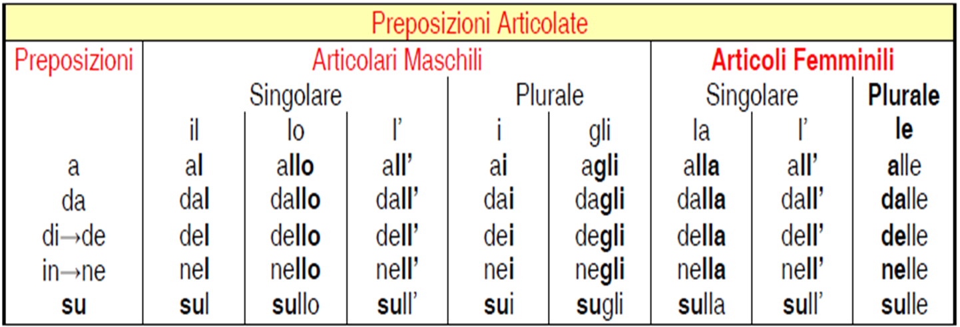

Slide 8
Andiamo al caffè
Vengono dall’aeroporto
Quali sono i giorni della settimana?
Metto il cappuccino sul tavolo
Can you identify what prepositions and definite articles are used to form these articulated prepositions????

Slide 9
Many contractions are used with expressions of time.
alle + hour = Alle cinque o alle sei? (at 5 or 6)
dalle + hour (from) = Lavoro dalle nove alle cinque
Fino alle + hour (Until...) = Dormono fino alle undici

