Slide 1

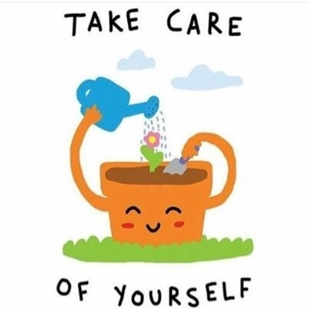
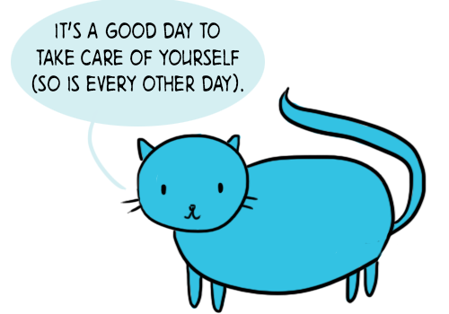
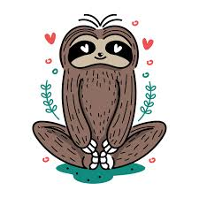
Wellbeing Day
Thursday 12th August 2021

Slide 2


‘People with the growth mindset know that it takes time for potential to flower.’
– Carol Dweck –
When we do 3 Good Things, we affirm what goes well in our lives. Recalling these events, and not taking them for granted, will grow our gratitude.
Write down 3 good things, or something positive noticed during a tough day, like beautiful weather
It is more effective if you write by hand rather than using an electronic device
The items you write can be short and specific. For example, a good thing could be a smile from a friend or an unexpected compliment at school

Slide 3
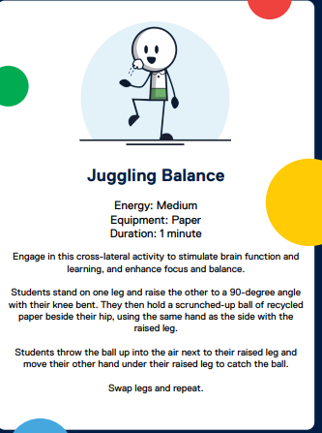
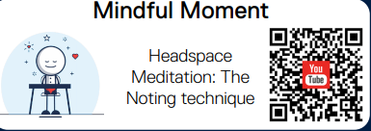
When I am Mindful, I notice the things I can see,, hear, taste, smell, and touch in front of me right now.
I can be mindful anytime.

Slide 4
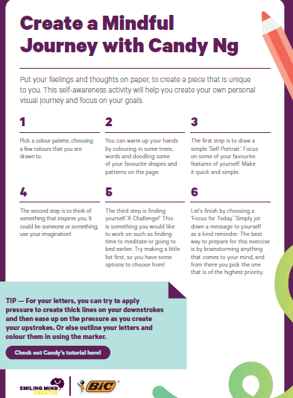
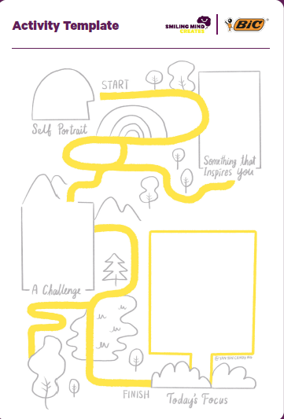
https://www.smilingmind.com.au/creates

Slide 5

Stay active
It’s pretty well known that exercise is really good for both our physical and mental health. There’s heaps of different types of exercise you can do from home, thanks to YouTube and apps. We’ve listed a few free ones:
Yoga with Adrienne is a well-loved yoga channel. She’s quirky and down-to-earth, and offers yoga classes lasting from five minutes through to an hour.
https://www.youtube.com/user/yogawithadriene
Nike Training Club can help you stay active during this time by offering heaps of free workouts you can do from home. It also features wellness and nutrition guidance from experts.
https://www.nike.com/au/ntc-app
https://au.reachout.com/articles/10-ways-to-take-care-of-yourself-during-coronavirus

Slide 6
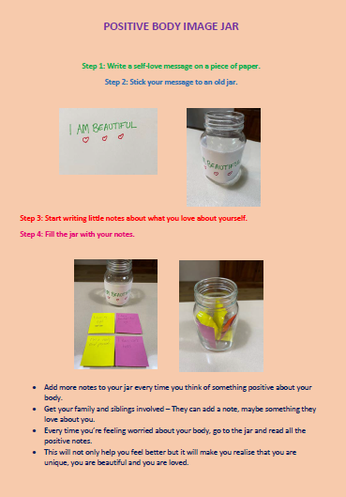
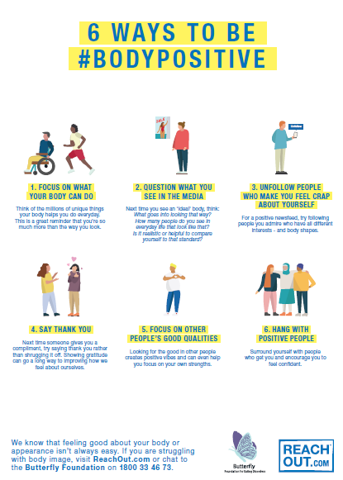


Slide 7
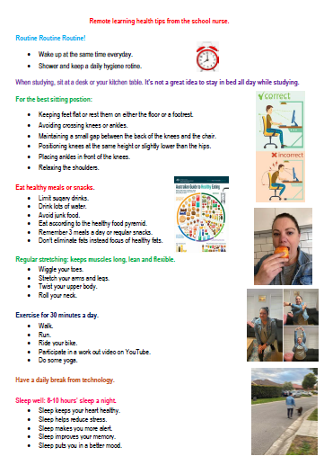
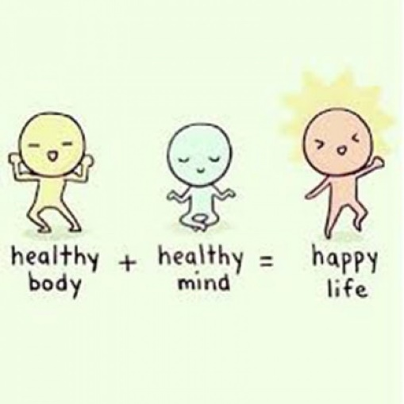
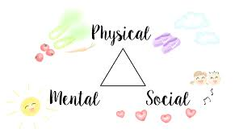
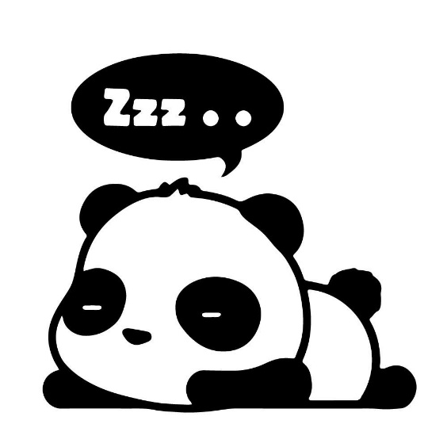
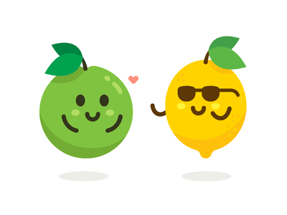

Slide 8
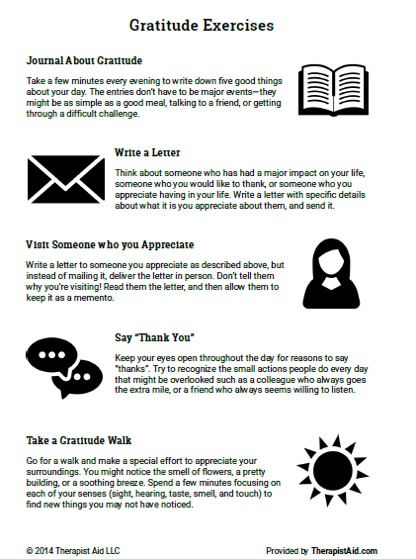
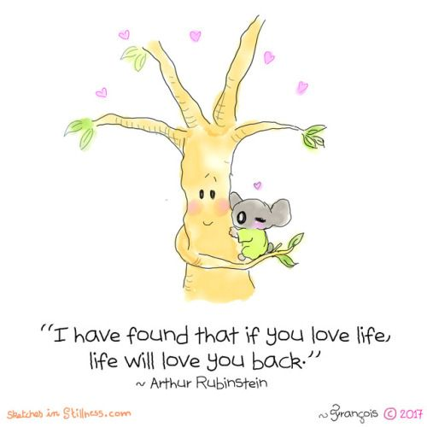

Slide 9
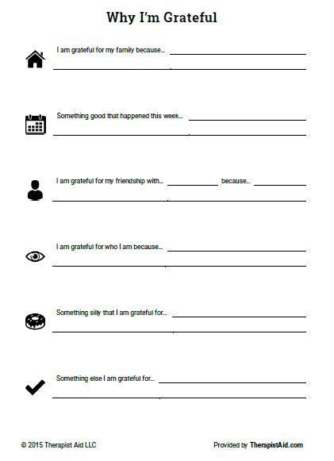



Slide 10
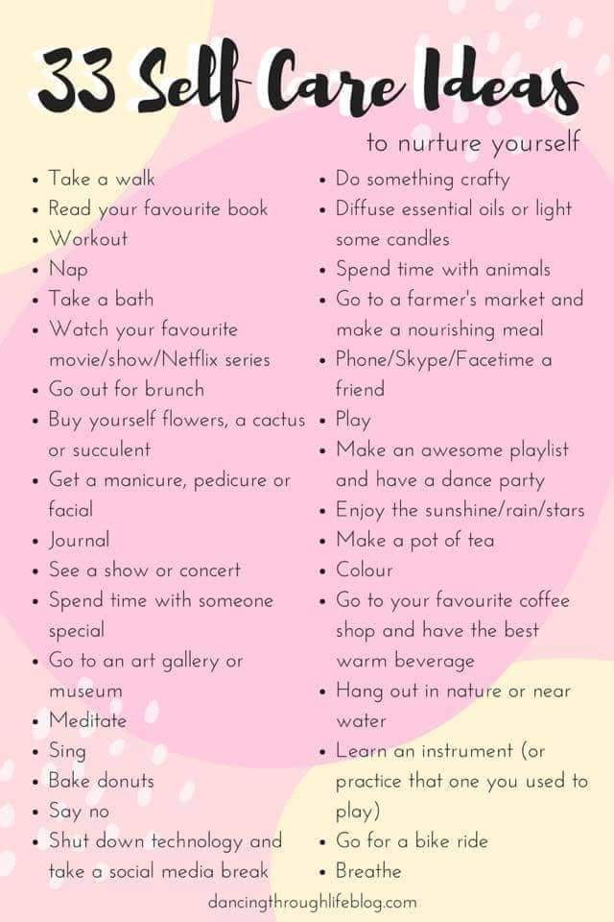


Slide 11
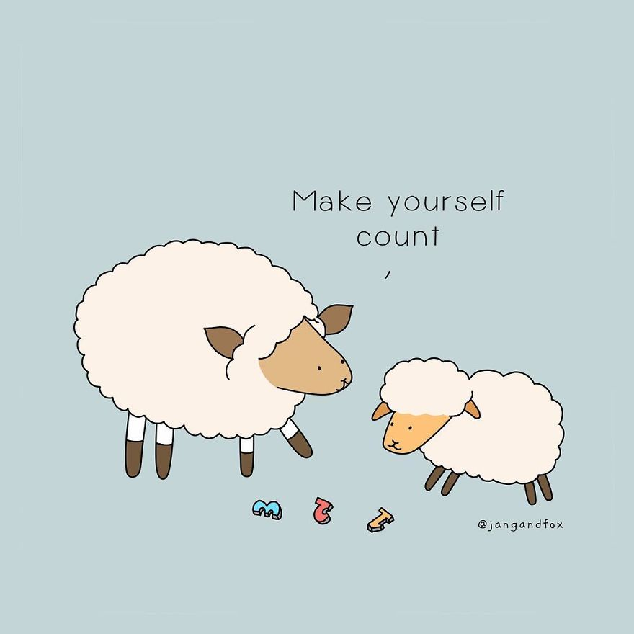

??Online Quizzes??
https://au.reachout.com/articles/how-are-you-going
https://au.reachout.com/articles/quiz-what-mindset-do-you-have
https://au.reachout.com/articles/quiz-what-kind-of-worker-are-you
https://au.reachout.com/healthy-friendship-group-quiz
https://au.reachout.com/articles/whats-your-chill-style
https://au.reachout.com/articles/quiz-whats-your-at-home-study-style
https://au.reachout.com/articles/quiz-how-to-deal-with-bullying

Slide 12
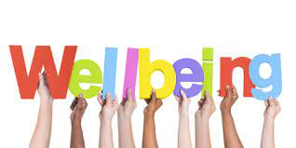
Lots more resources and activities can be found on the Craigieburn Student Wellbeing LMS page:
https://lms.craigieburnsc.vic.edu.au/course/view.php?id=367

