Slide 1
VTAC 2015
2016 course entry
Twitter: twitter.com/vtacguide | Blog: careersblog.vtac.edu.au | Facebook: www.facebook.com/vtacguide | YouTube: www.youtube.com/user/vtacmedia

Slide 2
About VTAC
VTAC provides tertiary application services for universities, TAFEs, and Independent Tertiary Colleges within Victoria:
  course applications;
  special consideration;
  scholarship applications; and
  admissions tests.
Calculates the ATAR for the Victorian cohort
Provides information and enquiry services to applicants and careers practitioners

Slide 3
The VTAC process
Find Courses
Register and Apply
SEAS and Scholarships
Change of Preference
Offers
We will also cover:
  The ATAR, scaling and privacy
  VCE Results and ATAR Service

Slide 4
Find Courses
Register and Apply
SEAS and Scholarships
Change of Preference
Offers

Slide 5

Finding courses – the VTAC eGuide 2016
Find Courses
Register and Apply
SEAS and Scholarships
Change of Preference
Offers
VTAC eGuide 2016
$4.99 RRP
  Available from Google Play Books and Apple iBooks
  VTAC recommends Google Play – less download time.
  Full entries for all courses, including selection criteria
  Searchable, with hyperlinks
  Can be read on- or off-line

Slide 6
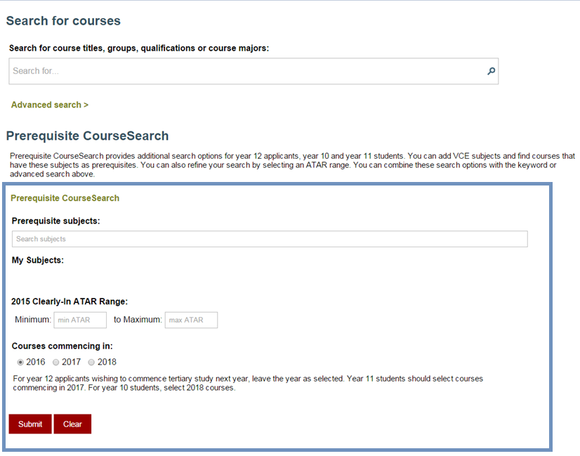
VTAC CourseSearch – finding courses online
Find Courses
Register and Apply
SEAS and Scholarships
Change of Preference
Offers

Slide 7
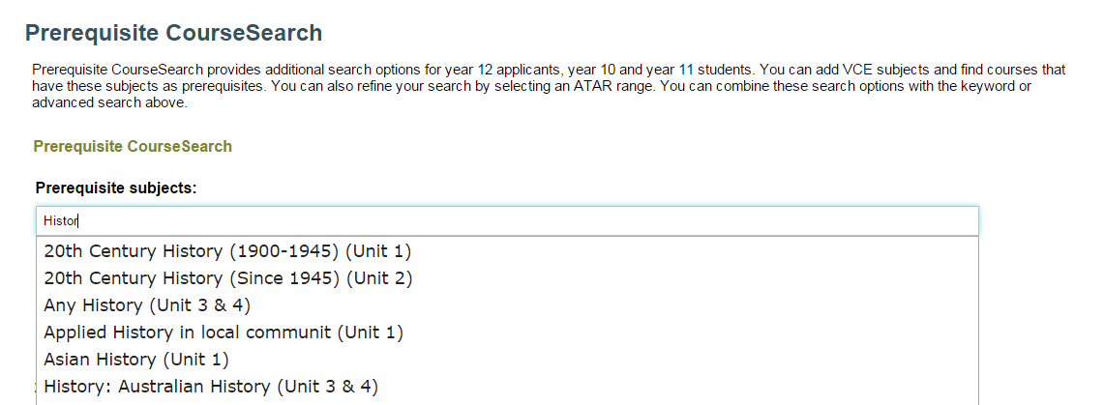
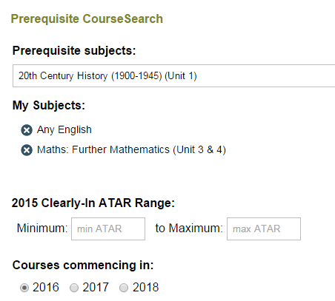
Find Courses
Register and Apply
SEAS and Scholarships
Change of Preference
Offers
Prerequisite CourseSearch – building a study program

Slide 8




Course types offered through VTAC
Find Courses
Register and Apply
SEAS and Scholarships
Change of Preference
Offers
Higher Education courses
Undergraduate
  Advanced Diploma
  Associate Degree
  Bachelor’s Degree
Postgraduate
  Graduate entry teaching
  Graduate entry (other)
VET courses
Certificate II
Certificate III
Certificate IV
Diploma
Advanced Diploma
Year 12 students under 20 years of age are usually eligible for government subsidised places.
Not relevant to Year 12 applicants

Slide 9
Fee types
Find Courses
Register and Apply
SEAS and Scholarships
Change of Preference
Offers
Course codes ending in
1: are Commonwealth supported places (subsidised)
2: are domestic full fee places
3: are international fee places
4: have the fee-type determined by provider at enrolment for example TAFE
(usually subsidised for Year 12 students under 20 years of age)

Slide 10
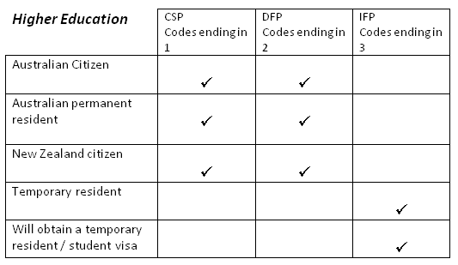
Which codes can I apply for?
Find Courses
Register and Apply
SEAS and Scholarships
Change of Preference
Offers

Slide 11
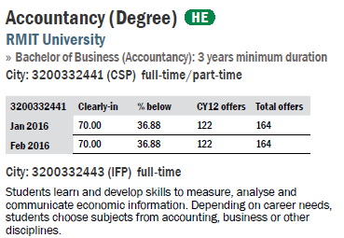
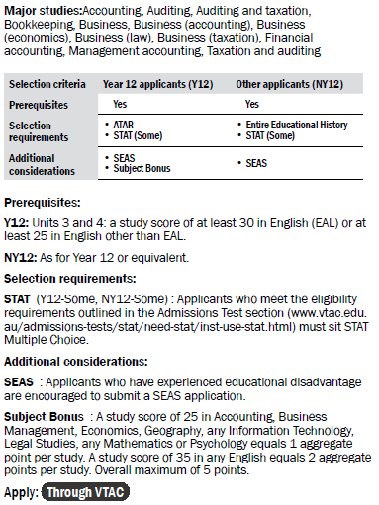
Reading course entries
Find Courses
Register and Apply
SEAS and Scholarships
Change of Preference
Offers
Course name
Qualification name
Campuses offered
Selection data
Course description
Major studies
Selection criteria
  Prerequisites
  Selection requirements
  Enrolment considerations
  Additional considerations

Slide 12
Applicant types
Find Courses
Register and Apply
SEAS and Scholarships
Change of Preference
Offers
Year 12 (Y12) | Non-Year 12 (NY12)
Current year 12 students Previously completed year 12 with no post-secondary studies or have post-secondary studies up to Certificate III level | Previously attempted or completed post secondary study at Certificate IV or above, or Currently enrolled in Year 12 but also have Cert. IV or above, or Has no secondary studies and no post-secondary studies at Certificate IV or above.
Applicants will be automatically informed of their Y12/NY12 classification after registering with VTAC

Slide 13
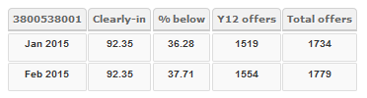
Selection data
Find Courses
Register and Apply
SEAS and Scholarships
Change of Preference
Offers
Clearly-in ATAR: the point above which everyone who applied for a course received an offer
% below: percentage of course offers made to applicants below the clearly-in ATAR
Y12 offers: the number of offers made to current Year 12 applicants
Total offers: the total number of offers made

Slide 14
Selection data: clearly-in and % below
Find Courses
Register and Apply
SEAS and Scholarships
Change of Preference
Offers
Applicants for an example course selecting on ATAR with 4 places and 6 applicants:
 | ATAR | Offered a place?
Harry | 95.00 | Yes
Zayn | 90.00 + subject bonus = 95.00 rank | Yes
Niall | 85.00 | Yes
Liam | 80.00 | No
Louis | 75.00 + SEAS + subject bonus = 86.00 rank | Yes
Justin | 70.00 | No
Clearly-in is 85.00: everyone at this ATAR or above received an offer
% below: One out of four offers was made to an applicant with an ATAR below 85.00, so the % below is 25%

Slide 15
Selection criteria
Find Courses
Register and Apply
SEAS and Scholarships
Change of Preference
Offers
Prerequisites | Studies that must be successfully completed to be considered for a course
Selection requirements | Additional requirements that must be completed by applicants to be considered for selection
Additional considerations | Factors that are not compulsory, but if applicable may boost an application
Enrolment considerations | Tasks that should be completed prior to enrolling or starting a course

Slide 16
Find Courses
Register and Apply
SEAS and Scholarships
Change of Preference
Offers

Slide 17
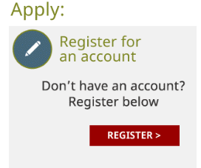
VTAC Registration
Find Courses
Register and Apply
SEAS and Scholarships
Change of Preference
Offers
All VTAC applications are completed online using the same ID and password
Registration is a simple question-based process
Students will choose their own VTAC PIN and be assigned a new VTAC ID that is not their VCAA student number
  The VCAA student number can no longer be used to log in to the VTAC user account

Slide 18
Registration – entering current enrolment information
Find Courses
Register and Apply
SEAS and Scholarships
Change of Preference
Offers
Are you currently studying the Victorian Certificate of Education (VCE, any unit level or VCAL), a standard interstate Australian year 12, or the International Baccalaureate (IB) in Australia or New Zealand?
 Yes, studying VCE (including VCAL) or standard interstate Australian year 12
 Yes, studying IB in Australia or New Zealand
 No
Current Year 12 students must answer this question correctly and enter their VCAA student number during the registration process
If the date of birth entered does not match the date recorded on VASS (shown on CourseLink), they will not be able to proceed with registration

Slide 19
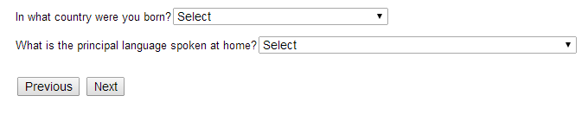
Residency status
Find Courses
Register and Apply
SEAS and Scholarships
Change of Preference
Offers
Citizenship type:
 I am an Australian citizen
 I am a New Zealand citizen
 I have an Australian residency visa
(If residency visa ticked then the following 3 lines to appear)
What type of visa do you currently have?  temporary/student  permanent
When was this visa granted?
What is the visa sub class (number or letter printed on visa)?
Is your visa considered a “humanitarian visa”?  yes  no

Slide 20
Registration tips
Find Courses
Register and Apply
SEAS and Scholarships
Change of Preference
Offers
One registration only
  To correct errors, change the details online or call VTAC. Do not create another registration.
Use a personal, not school email address
  Some school email addresses are deactivated by the time offer emails are sent
Four digit PIN
  Lost PINs can be retrieved from the log in form.
Nominate a proxy if needed
  VTAC cannot discuss individual applications with anyone except the applicant and authorised nominee.

Slide 21
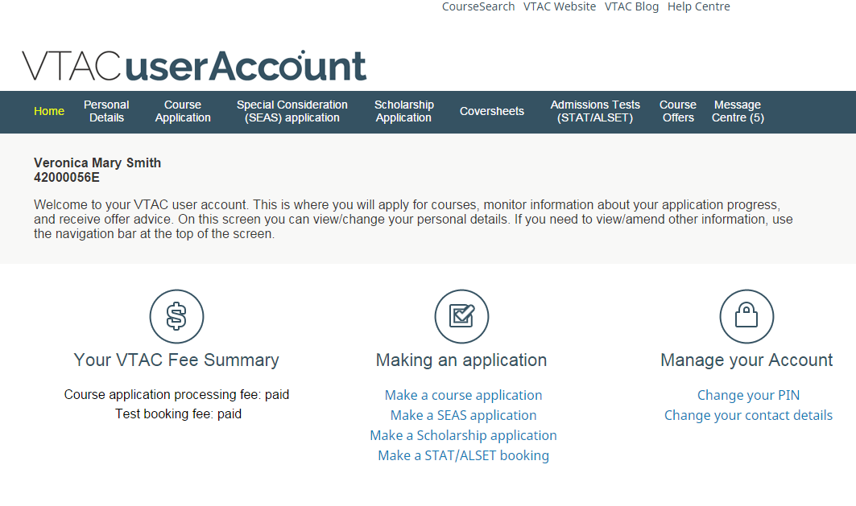
Find Courses
Register and Apply
SEAS and Scholarships
Change of Preference
Offers

Slide 22
Course application dates and fees
Find Courses
Register and Apply
SEAS and Scholarships
Change of Preference
Offers
Please remember that
  merely registering with VTAC does not constitute a course application; and
  unpaid applications are not forwarded to institutions.
Key dates for 2015-2016 applications
Applications open | 9am, Monday 3 August 2015
Timely applications ($29 for current Year 12 students) close | 5pm, Wednesday 30 September 2015
Late applications ($95) close | 5pm, Friday 6 November 2015
Very late applications ($121) close | 5pm, Friday 4 December 2015
Final payment deadline | 4pm, Tuesday 15 December (International VCE applicants) 4pm, Monday 21 December (all applicants)

Slide 23
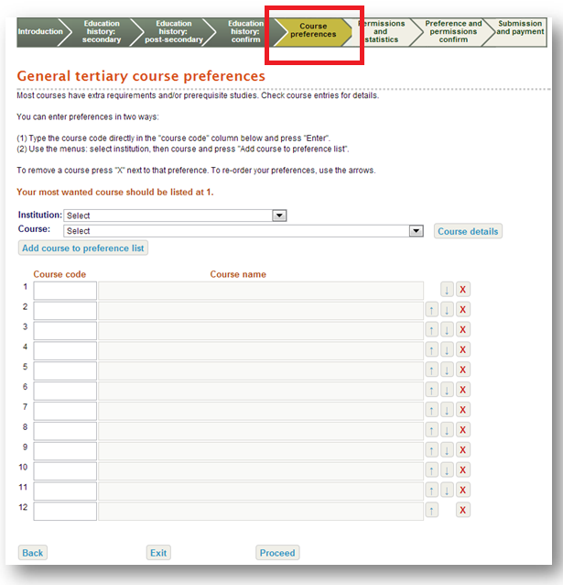
Applying for courses
Find Courses
Register and Apply
SEAS and Scholarships
Change of Preference
Offers
List up to 12 courses/institutions
Preference order – always list them in the order you want to get into the course
To add course preferences: Select institution and course or type in the course code.
To move a course on the preference list use the up/down buttons.
To delete a course use the x button.
If courses with early closing dates are removed after the deadline, they cannot be re-added.

Slide 24
Find Courses
Register and Apply
SEAS and Scholarships
Change of Preference
Offers

Slide 25
Special Entry Access Scheme (SEAS)
Find Courses
Register and Apply
SEAS and Scholarships
Change of Preference
Offers
Allows selection officers to grant special consideration to applicants for course entry whose education has been impacted by disadvantage
It is not a get out of jail free card or a guarantee to getting into a course

Slide 26
What can SEAS do?
Find Courses
Register and Apply
SEAS and Scholarships
Change of Preference
Offers
SEAS allows selection officers at institutions to grant special consideration for course entry to applicants.
SEAS does not exempt applicants from meeting course requirements.
  Applicants must meet course prerequisites, attend all interviews, sit any required tests, and submit all required folios and forms.
 | ATAR | Offered a place?
Harry | 95.00 | Yes
Zayn | 90.00 + subject bonus = 95.00 rank | Yes
Niall | 85.00 | Yes
Liam | 80.00 | No
Louis | 75.00 + SEAS + subject bonus = 86.00 rank | Yes
Justin | 70.00 | No

Slide 27
Applying for SEAS
Find Courses
Register and Apply
SEAS and Scholarships
Change of Preference
Offers
SEAS application becomes available after a course application is submitted
All of the categories will be on one page
Apply for as many categories as are applicable

Slide 28
SEAS categories
Find Courses
Register and Apply
SEAS and Scholarships
Change of Preference
Offers
Category 1: Personal information and location
Category 2: Difficult circumstances
Category 3: Disadvantaged financial background
Category 4: Disability or medical condition

Slide 29
Category 1 – Personal Information and Location
Find Courses
Register and Apply
SEAS and Scholarships
Change of Preference
Offers
Consideration for circumstances based on information applicants provide when registering and/or applying for courses.
Applying for Category 1 is as simple as ticking a box giving VTAC permission for those circumstances to be considered.
All applicants should apply for this category.
Category 1 includes:
Age
Gender
Living or school location
Recognition as an Indigenous Australian
Under-represented schools
Non-English speaking background
First in family (new)

Slide 30
Category 2 – Difficult Circumstances
Find Courses
Register and Apply
SEAS and Scholarships
Change of Preference
Offers
Education affected by family or life events
Examples include:
  Disruption to living situation
  Affected by death of relative/friend
  Natural disaster
  Refugee
Must submit impact statement and statement of support

Slide 31
Category 3 – Disadvantaged financial background
Find Courses
Register and Apply
SEAS and Scholarships
Change of Preference
Offers
Education impacted by disadvantaged financial background, for example:
  Individual or family poverty
  Excessive financial obligations
  Economic hardship
Not limited to applicants in receipt of Centrelink benefits.
  Applicants who are not in receipt of Centrelink benefits must submit an impact statement and a statement of support

Slide 32
SEAS documentation
Category 3 (disadvantaged financial background)
Find Courses
Register and Apply
SEAS and Scholarships
Change of Preference
Offers
If applicant personally receives a Centrelink benefit:
  Applicant’s Centrelink Customer Reference Number (CRN)
  Do not provide parent’s CRN – names will not match, and Centrelink will not release data to VTAC
If family members receive a Centrelink benefit:
  Documentary evidence – relationship to applicant indicated
    Check dates required

Slide 33
Category 4 – Disability or medical condition
Find Courses
Register and Apply
SEAS and Scholarships
Change of Preference
Offers
Educational disadvantage as a result of a disability or medical condition experienced by the applicant.
Must provide an impact statement and a statement of support from the treating healthcare professional that details the condition, its duration and impact.
Important to start make appointments early to ensure statements of support are ready before the closing date.

Slide 34
SEAS impact statements
Find Courses
Register and Apply
SEAS and Scholarships
Change of Preference
Offers
Impact statements should include how circumstances have adversely affected:
  Ability to study and perform assessment tasks
  Access to educational resources
  Attendance in school/tuition
Good impact statements are:
  Personal and sincere
  Succinct
  Explain the context, date and impact of the disadvantage on studies
Impact statements are completed online by the applicant.

Slide 35
SEAS statements of support
Find Courses
Register and Apply
SEAS and Scholarships
Change of Preference
Offers
Applicants should ask those providing a statement of support to:
  Clearly outline the situation, or if Category 4 (disability or medical) condition
  Include a timeline, such as how long they have known (or been treating) the applicant
  Outline how the applicant has been impacted
Encourage students to make medical appointments now. Statements of support can be collected now, and submitted once applications open.
Evidence and impact is the key.
Statements of support can be submitted online or in hard copy.

Slide 36
Poor statements of support
Find Courses
Register and Apply
SEAS and Scholarships
Change of Preference
Offers
“Call me for more details”
“See scholarship statement for more info” (or vice versa)
“Student has told me”
“School is aware of the circumstances”
Vague support, e.g.
  not mentioning the circumstances
  generic statements that don’t differentiate between student impact when a group is affected
  orchestrated or professionally moderated statements
  blank statements
  too long-winded, circumstances obscured

Slide 37
How to provide statements of support
Find Courses
Register and Apply
SEAS and Scholarships
Change of Preference
Offers
Online statements
  Can be combined with Scholarships if option selected
Hard copy by post
Scanned and uploaded documents
Hard copy or scanned statements cannot be combined with Scholarships application

Slide 38
Hard copy SEAS documentation
Find Courses
Register and Apply
SEAS and Scholarships
Change of Preference
Offers
Download personalised cover sheet from VTAC user account, and send with documentation by post
Make sure correct cover sheet is used
  Hard copy SEAS documentation cannot be used for Scholarships and vice versa due to privacy regulations

Slide 39
Scholarships
Find Courses
Register and Apply
SEAS and Scholarships
Change of Preference
Offers
VTAC collects scholarship applications for many institutions
  One application, many institutions
Scholarships are not just for academic performance
Many equity scholarships have similar documentation requirements to SEAS
  Statements must be submitted separately for each using the correct coversheet.
List of scholarships available on the VTAC website
  Including scholarships which require direct applications to institutions

Slide 40
Find Courses
Register and Apply
SEAS and Scholarships
Change of Preference
Offers

Slide 41
Change of Preference
Find Courses
Register and Apply
SEAS and Scholarships
Change of Preference
Offers
You can change your course preferences free-of-charge as many times as you like while Change of Preference is open
Change of Preference
  opens at the same time as course applications;
  get your preferences in and correct by 21 December.
  closes a short time before each offer round; and
  reopens at 10am the day after each offer round (until the last round).
Check deadlines and opening times at www.vtac.edu.au

Slide 42
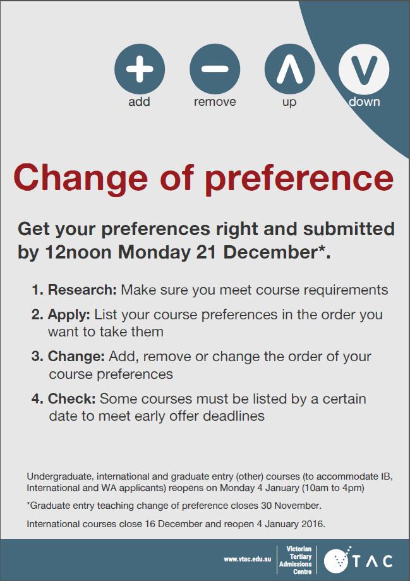
Get it right by 21 December
Find Courses
Register and Apply
SEAS and Scholarships
Change of Preference
Offers
Institutions will continue to make the vast majority of offers in Round 1
Courses are not required to participate in subsequent rounds
There is no guarantee of receiving an offer in a later round
Download VTAC’s poster and newsletter ads to promote this deadline within your school.

Slide 43
Find Courses
Register and Apply
SEAS and Scholarships
Change of Preference
Offers

Slide 44
Responding to an offer
Find Courses
Register and Apply
SEAS and Scholarships
Change of Preference
Offers
To accept an offer, follow the instructions in the offer advice to enrol at the institution.
  No separate acceptance notification to VTAC is needed.
To defer an offer, contact the institution.
  Not all courses allow deferment.
To reject an offer, take no action.
  The offer will automatically lapse if the applicant has not enrolled by the deadline.

Slide 45
Always accept an offer
Find Courses
Register and Apply
SEAS and Scholarships
Change of Preference
Offers
Even if a student is hoping for a higher preference offer in a later round, they should still accept any offer they have received
There is no guarantee of receiving another offer in a later round
If they do receive another offer in a later round, they can withdraw from the earlier offer at that point

Slide 46
Didn’t get an offer, or the offer you wanted?
Find Courses
Register and Apply
SEAS and Scholarships
Change of Preference
Offers
Applicants are automatically considered for any higher preferences in future offer rounds
When Change of Preference reopens, consider adding more backup course options
  Preferences can now be changed between all five rounds
  Make use of all 12 preferences – very popular courses may have filled all their places in Round 1

Slide 47
Changing preferences after a round
Find Courses
Register and Apply
SEAS and Scholarships
Change of Preference
Offers
Once you have received an offer for a course, you cannot remove that course from your preferences list – you can only move it up or down
If you want to be considered for higher preference courses:
  There is no need to change your preferences. You will be considered for any higher preference courses automatically.
If you want to be considered for all of your other preferences:
  Move the offered course to the bottom of your preferences list.
If you don’t want to be considered for any other offers:
  Move the offered course to the top of your list.
If you want to be considered for new courses:
  Add them to your preferences. Just make sure that they are above the course you have already been offered, otherwise you won’t be considered for an offer.

Slide 48
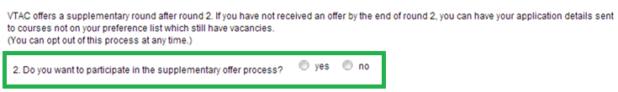
Supplementary offers
Find Courses
Register and Apply
SEAS and Scholarships
Change of Preference
Offers
For applicants who have given permission and not yet received an offer
Institutions will contact them directly to suggest courses which still have vacancies
Supplementary offers will commence after Round 2, and be formalised in the next offer round
Opt-in by the deadline, opt-out at anytime

Slide 49
Scaling and the ATAR

Slide 50
Scaling
The strength of competition is different in different studies because the students who take them are different
The VCAA produces study scores where 30 is the mean for that subject
VTAC scales these study scores so that a 30 in one subject means the same thing as a 30 in another subject
Strength of competition is measured by how well the students performed in their other studies.
  Competition is high—study scores are scaled up.
  Competition is low—study scores are scaled down.

Slide 51
How scaling works
VCAA
Responsible for assessment of studies
VTAC
Calculates ATAR based on Study Scores, so need to ensure a 30 in one study = 30 in all others
Produces raw Study Score (mean = 30)
Determines performance of individuals in each study
Adjusts study scores by looking at competition (scaling)
Based on scaled Study Scores, ensuring that students are not advantaged or disadvantaged because of their subject choice
ATAR

Slide 52
Australian Tertiary Admission Rank
The ATAR is a number from 0.05 to 99.95 which reflects a Year 12 student’s rank in overall VCE performance among their age group.
The ATAR allows institutions to compare students even though they have taken different combinations of VCE subjects.
The ATAR is calculated by each state’s TAC, and is equivalent between states (except Queensland).
  For example, an ATAR of 75.00 in Victoria is the same as an ATAR of 75.00 in NSW for tertiary admission

Slide 53
How the ATAR is calculated
Highest eligible English group subject
Next highest eligible subject
Next highest eligible subject
Next highest eligible subject
10% of next highest (or other increment)
10% of next highest (or other increment)
The “Primary 4” subjects (required to receive an ATAR)
Increments (only if available)

Slide 54
How the ATAR is calculated
The VTAC Scaled Study Scores of the Primary 4 subjects and any available increments are added together to produce an aggregate score
The aggregate score is then converted to an ATAR – the rank which shows how well a student has performed compared to other students
  For example, an ATAR of 60.00 means that a student has outperformed 60% of Year 12 age students

Slide 55
VCE Results and ATAR Service

Slide 56
Separate IDs and PINs
VCE Student Number
and
Results Service PIN
VCE Results and ATAR Service
VTAC ID
and
VTAC PIN
VTAC User Account
(course applications, SEAS, scholarships)

Slide 57
Remember:
Contact details
  For more information and to apply:
  www.vtac.edu.au
  Questions?
  Call VTAC on 1300 364 133
  Email VTAC through the VTAC website
  Send us a private message on Facebook (facebook.com/vtacguide)
  Tweet @vtacguide or DM us
  Find more information at blog.vtac.edu.au
Connect with VTAC on social media for timely reminders and tips
Use CourseSearch and the VTAC Guide to find courses
One application, twelve preferences
Apply for SEAS category 1 (and other categories if appropriate)
Apply for scholarships
Change of Preference is open before and between offer rounds
Change your Results Service PIN to protect your ATAR
Notes:
Leave contact details on screen and take questions

